Slide 1
KUBERNETES

Slide 2
KUBERNETES

Slide 3
OBJECTIVES
What is Kubernetes?
Kubernetes Architecture
Kubernetes Components
Kubernetes vs.Docker Swarm Comparison
Kubernetes and DevOps: How it works
Notes:
This brownbag …
* is an overview of Kubernetes
* is not intended to solve real-world scenario
* is not intended to turn you into Kubernetes expert…yet

Slide 4
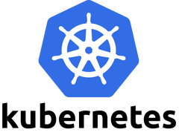
KUBERNETES
Kubernetes is a powerful open-source system, initially developed by Google, for managing containerized applications in a clustered environment. It aims to provide better ways of managing related, distributed components and services across varied infrastructure.
Notes:
Kubernetes is an open source system for managing containerized applications across multiple hosts; providing basic mechanisms for deployment, maintenance, and scaling of applications.
Kubernetes builds upon years of experience at Google running production workloads at scale (using a system called Borg), combined with best-of-breed ideas and practices from the community.
Kubernetes is hosted by the Cloud Native Computing Foundation (CNCF). If you are a company that wants to help shape the evolution of technologies that are container-packaged, dynamically-scheduled and microservices-oriented, consider joining the CNCF. For details about who's involved and how Kubernetes plays a role, read the CNCF announcement.

Slide 5
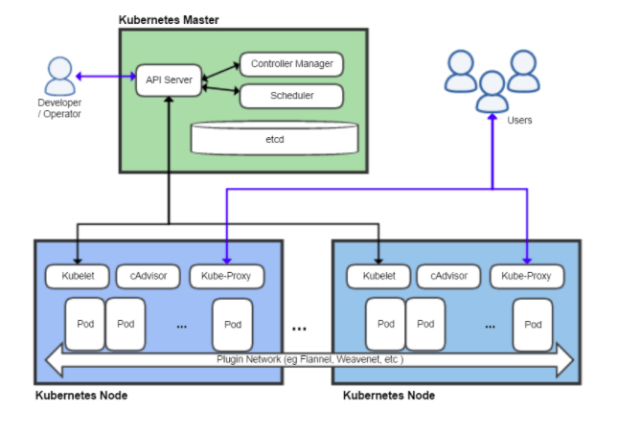
Kubernetes Architecture
Kubernetes can be visualized as a system built in layers, with each higher layer abstracting the complexity found in the lower levels.

Slide 6
Kubernetes Architecture
Kubernetes Master
This server acts as a gateway and brain for the cluster by exposing an API for users and clients, health checking other servers, deciding how best to split up and assign work (known as "scheduling"), and orchestrating communication between other components. The master server acts as the primary point of contact with the cluster and is responsible for most of the centralized logic Kubernetes provides.

Slide 7
Kubernetes Architecture
Kubernetes Node
This servers responsible for accepting and running workloads using local and external resources. To help with isolation, management, and flexibility, Kubernetes runs applications and services in containers, so each node needs to be equipped with a container runtime (like Docker or rkt). The node receives work instructions from the master server and creates or destroys containers accordingly, adjusting networking rules to route and forward traffic appropriately.

Slide 8
KUBERNETES COMPONENTS
Master Components
Master components provide the cluster’s control plane. Master components make global decisions about the cluster (for example, scheduling), and detecting and responding to cluster events (starting up a new pod when a replication controller’s ‘replicas’ field is unsatisfied). Master components can be run on any machine in the cluster. However, for simplicity, set up scripts typically start all master components on the same machine, and do not run user containers on this machine. See Building High-Availability Clusters for an example multi-master-VM setup.

Slide 9
MASTER COMPONENTS
kube-apiserver
Component on the master that exposes the Kubernetes API. It is the front-end for the Kubernetes control plane. It is designed to scale horizontally – that is, it scales by deploying more instances.
etcd
Consistent and highly-available key value store used as Kubernetes’ backing store for all cluster data. Always have a backup plan for etcd’s data for your Kubernetes cluster.
kube-scheduler
Component on the master that watches newly created pods that have no node assigned, and selects a node for them to run in. Factors taken into account for scheduling decisions include individual and collective resource requirements, hardware/software/policy constraints, affinity and anti-affinity specifications, data locality, inter-workload interference and deadlines.
Notes:
https://kubernetes.io/docs/reference/command-line-tools-reference/kube-apiserver/
https://kubernetes.io/docs/reference/command-line-tools-reference/kube-scheduler/
The Kubernetes scheduler is a policy-rich, topology-aware, workload-specific function that significantly impacts availability, performance, and capacity.

Slide 10
MASTER COMPONENTS
kube-controller-manager
Component on the master that runs controllers. Logically, each controller is a separate process, but to reduce complexity, they are all compiled into a single binary and run in a single process.
cloud-controller-manager
cloud-controller-manager runs controllers that interact with the underlying cloud providers. The cloud-controller-manager binary is an alpha feature introduced in Kubernetes release 1.6.
Notes:
In Kubernetes, a controller is a control loop that watches the shared state of the cluster through the apiserver and makes changes attempting to move the current state towards the desired state.
Cloud-controller-manager is a daemon that embeds cloud-specific control loops. These cloud-specific control loops were originally in the kube-controller-manager. Since cloud providers develop and release at a different pace compared to the Kubernetes project, abstracting the provider-specific code to the cloud-controller-manager binary allows cloud vendors to evolve independently from the core Kubernetes code.

Slide 11
KUBERNETES COMPONENTS
2. Node Components
Node components run on every node, maintaining running pods and providing the Kubernetes runtime environment.
kubelet
An agent that runs on each node in the cluster. It makes sure that containers are running in a pod.
The kubelet takes a set of PodSpecs that are provided through various mechanisms and ensures that the containers described in those PodSpecs are running and healthy. The kubelet doesn’t manage containers which were not created by Kubernetes.
kube-proxy
kube-proxy enables the Kubernetes service abstraction by maintaining network rules on the host and performing connection forwarding.
Container Runtime
The container runtime is the software that is responsible for running containers. Kubernetes supports several runtimes: Docker, rkt, runc and any OCI runtime-spec implementation.
Notes:
https://kubernetes.io/docs/reference/command-line-tools-reference/kubelet/
A PodSpec is a YAML or JSON object that describes a pod.
Pod
The smallest and simplest Kubernetes object. A Pod represents a set of running containers on your cluster
The Kubernetes network proxy runs on each node. This reflects services as defined in the Kubernetes API on each node and can do simple TCP, UDP, and SCTP stream forwarding or round robin TCP, UDP, and SCTP forwarding across a set of backends.

Slide 12
KUBERNETES COMPONENTS
3. ADD-Ons Components
Addons are pods and services that implement cluster features. The pods may be managed by Deployments, ReplicationControllers, and so on. Namespaced addon objects are created in the kube-system namespace.

Slide 13
ADD-ONS COMPONENTS
DNS
While the other addons are not strictly required, all Kubernetes clusters should have cluster DNS, as many examples rely on it.Cluster DNS is a DNS server, in addition to the other DNS server(s) in your environment, which serves DNS records for Kubernetes services. Containers started by Kubernetes automatically include this DNS server in their DNS searches.
Web UI (Dashboard)
Dashboard is a general purpose, web-based UI for Kubernetes clusters. It allows users to manage and troubleshoot applications running in the cluster, as well as the cluster itself.
Container Resource Monitoring
Container Resource Monitoring records generic time-series metrics about containers in a central database, and provides a UI for browsing that data.
Cluster-level Logging
A Cluster-level logging mechanism is responsible for saving container logs to a central log store with search/browsing interface.

Slide 14
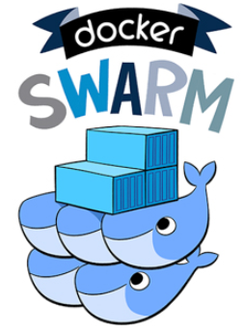
Kubernetes VS. Docker Swarm Comparison
Kubernetes
is an open-source platform created by Google for container deployment operations, scaling up and down, and automation across the clusters of hosts. This production-ready, enterprise-grade, self-healing (auto-scaling, auto-replication, auto-restart, auto-placement) platform is modular, and so it can be utilized for any architecture deployment.
Docker Swarm
As a platform, Docker has revolutionized the manner software was packaged. Docker Swarm or simply Swarm is an open-source container orchestration platform and is the native clustering engine for and by Docker. Any software, services, or tools that run with Docker containers run equally well in Swarm. Also, Swarm utilizes the same command line from Docker.

Slide 15
Kubernetes VS. Docker Swarm Comparison
 | KUBERNETES | DOCKER SWARM
Application definition | An application can be deployed in Kubernetes utilizing a combination of services (or microservices), deployments, and pods. | The applications can be deployed as micro-services or services in a swarm cluster in Docker Swarm. YAML files can be utilized to identify multi-container. Moreover, Docker compose can install the application.
Networking | The networking model is a flat network, allowing all pods to interact with one another. The network policies specify how the pods interact with each other. The flat network is implemented typically as an overlay. The model needs two CIDRs: one for the services and the other from which pods acquire an IP address. | The Node joining a swarm cluster generates an overlay network for services that span every host in the docker swarm and a host-only docker bridge network for containers. The users have a choice to encrypt container data traffic while creating an overlay network by on their own in docker swarm
Notes:
YAML = YAML Ain’t Markup Language

Slide 16
Kubernetes VS. Docker Swarm Comparison
 | KUBERNETES | DOCKER SWARM
Scalability | For distributed systems, Kubernetes is more of an all-in-one framework. It is a complex system because it provides strong guarantees about the cluster state and a unified set of APIs. This slows down container scaling and deployment. | Docker Swarm, when compared to Kubernetes, can deploy container much faster and this allows faster reaction times to scale on demand.
High Availability | All the pods in kubernetes are distributed among nodes and this offers high availability by tolerating the failure of application. Load balancing services in kubernetes detect unhealthy pods and get rid of them. So, this supports high availability. | As the services can be replicated in Swarm nodes, Docker Swarm also offers high availability. The Swarm manager nodes in Docker Swarm are responsible for the entire cluster and handle the worker nodes’ resources.

Slide 17
Kubernetes VS. Docker Swarm Comparison
 | KUBERNETES | DOCKER SWARM
Container Setup | Kubernetes utilizes its own YAML, API, and client definitions and each of these differ from that of standard docker equivalents. That is to say, you cannot utilize Docker Compose nor Docker CLI to define containers. While switching platforms, YAML definitions and commands need to be rewritten. | The Docker Swarm API doesn’t entirely encompass all of Docker’s commands but offers much of the familiar functionality from Docker. It supports most of the tools that run with Docker. Nevertheless, if Docker API is deficient of a particular operation, there doesn’t exist an easy way around it utilizing Swarm.
Load Balancing | Pods are exposed via service, which can be utilized as a load balancer within the cluster. Generally, an ingress is utilized for load balancing. | Swarm mode consists of a DNS element that can be utilized for distributing incoming requests to a service name. Services can be assigned automatically or can run on ports specified by the user.

Slide 18
Kubernetes and DevOps: How it works
As a portable open-source system for automating functions such as deployment, scaling, management and orchestration of applications organized as distinct logical units or clusters, Kubernetes has been significantly useful as a cloud program in the realm of DevOps.
Considered as a breakthrough for DevOps, Kubernetes works on a ‘write once, run anywhere’ principle. It is enabled to control deployments, and not just infrastructure in addition to providing support for introspection and debugging.

Slide 19
Kubernetes and DevOps: How it works
Cluster computing
Developed by Google, Kubernetes is functionally designed to be readily accessible and available as a cluster of computers that are linked together to work as a single unit. This precludes the need to consider factors of machine compatibility and installation to support specific functionalities. Deploying this necessitates packaging individual applications as containers; that is, detaching them from individual hosts.
Notes:
deployment, maintenance, and scaling

Slide 20
Kubernetes and DevOps: How it works
Extendable application platform that supports third-party apps
Enabled with a container runtime interface (CRI), Kubernetes offers a certain degree of extensibility. Inherently feature-rich, Kubernetes allows for the use of different container apps such as Docker containers, rkt, Windows containers, and others based on an open container initiative (OCI). As a tool, Kubernetes ensures that third-party resources help users work with their own custom features such as scheduling. As it enables seamless deployment of applications such as Cassandra, Spark, MySQL, and so on merely with the push of a button, Kubernetes provides ample flexibility by allowing users to choose an optimal container orchestration system that suits a specific purpose. Additionally, its user-driven OS facilitates easier selection of a container orchestrator. Kubernetes makes it easy to leverage containers to modularize apps.

Slide 21
Kubernetes and DevOps: How it works
Infrastructure enhancement
Based on user and ecosystem needs, Kubernetes is particularly looking at expanding its functionalities through several infrastructural enhancements in terms of increased storage capabilities, scheduler capabilities and client capabilities. Additionally, installation is being streamlined by seamlessly integrating it with its dependencies for distributors such as Linux. This enables quick installation across several platforms. Not just that, Kubernetes also seeks to cut infrastructure costs to a reasonable extent in large scale deployments. The overhead deployment costs are significantly reduced owing to its cluster system. Kubernetes efficiently runs several containers on the same hosts, making maximum use of the available resources. This reduces the number of required servers, thereby largely reducing costs.

Slide 22
Kubernetes and DevOps: How it works
Native deployment support
Equipped with native support for deployment, Kubernetes has an infrastructure that supports horizontal auto-scaling. This means that it can dynamically scale-out services on the basis of memory usage. Not just that, Kubernetes enables deployment of a new version of a software alongside its previous version by routing traffic progressively.

Slide 23
Kubernetes and DevOps: How it works
Intelligently engineered
Coming from Google, Kubernetes is designed to handle issues that would come up in the realm of distributed computing and container orchestration. With a thoughtfully laid out architecture, Kubernetes is poised to take full advantage of cloud and is scalable to a large extent across several platforms. Kubernetes is, therefore, seen as a front-runner in shaping the future of DevOps, going forward. It offers numerous advantages over other computing environments by being self-healing, enabling faster container cluster management, and guaranteeing developers and engineers to experience faster performance and better redundancy.

Slide 24
Reference
https://suyati.com/blog/kubernetes-future-devops/
https://www.digitalocean.com/community/tutorials/an-introduction-to-kubernetes#kubernetes-objects-and-workloads

